Slide 1
Diffusion Model Project
By Miguel Pinel Martínez
Deep Learning 2022

Slide 2
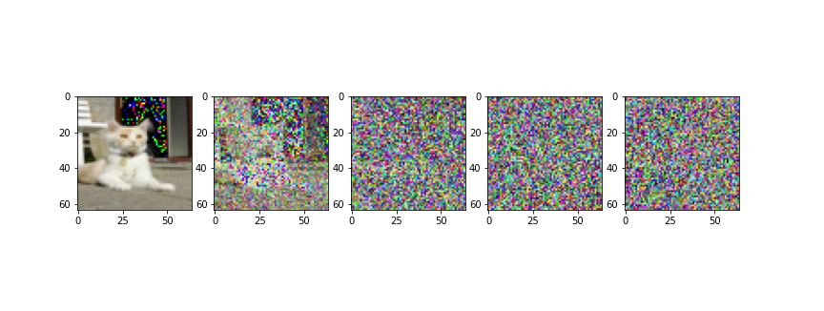
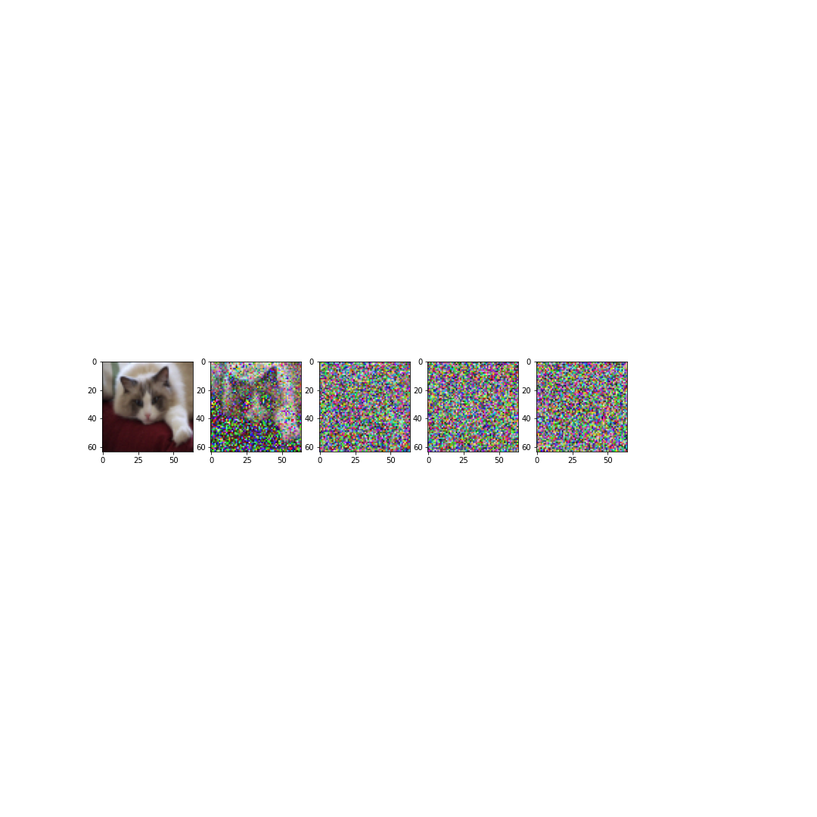
General overview
Forward diffusion process
Reverse diffusion process
Objective:
Start with random noise
End with an original image

Slide 3

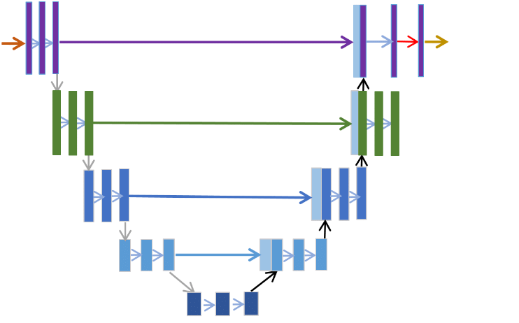
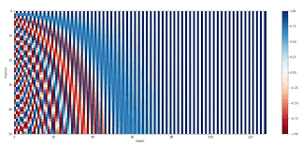
Main Components
Denoising predictor
(neural network)
Noise schedule
Timestep Embedding

Slide 4

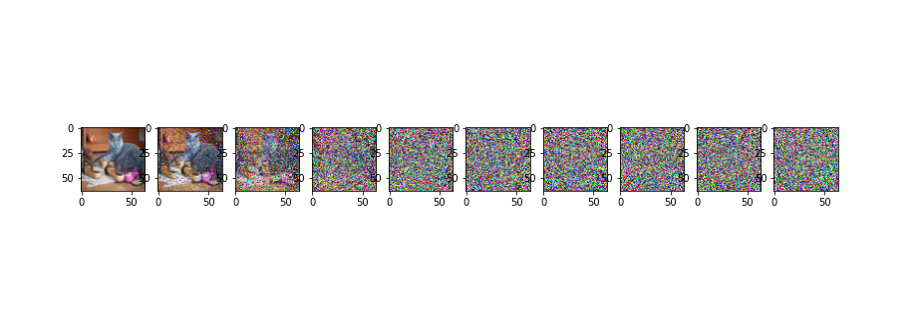
Noise schedule
New Image
Previous Image
Noise parameter
What does the noise schedule do?
It increase the noise parameter in each timestep. We will use a linear one.
Low increase in noise
High increase in noise

Slide 5


Noise schedule optimization I
Can we calculate everything at one?
Reparameterization trick:
Notation:
Alphas
Cumulative Alphas

Slide 6


Noise schedule optimization II
So the final formula for calculating a timestep t:
Now we can calculate directly the noise version of an image in any timestep without needing to calculate all the intermediate steps

Slide 7
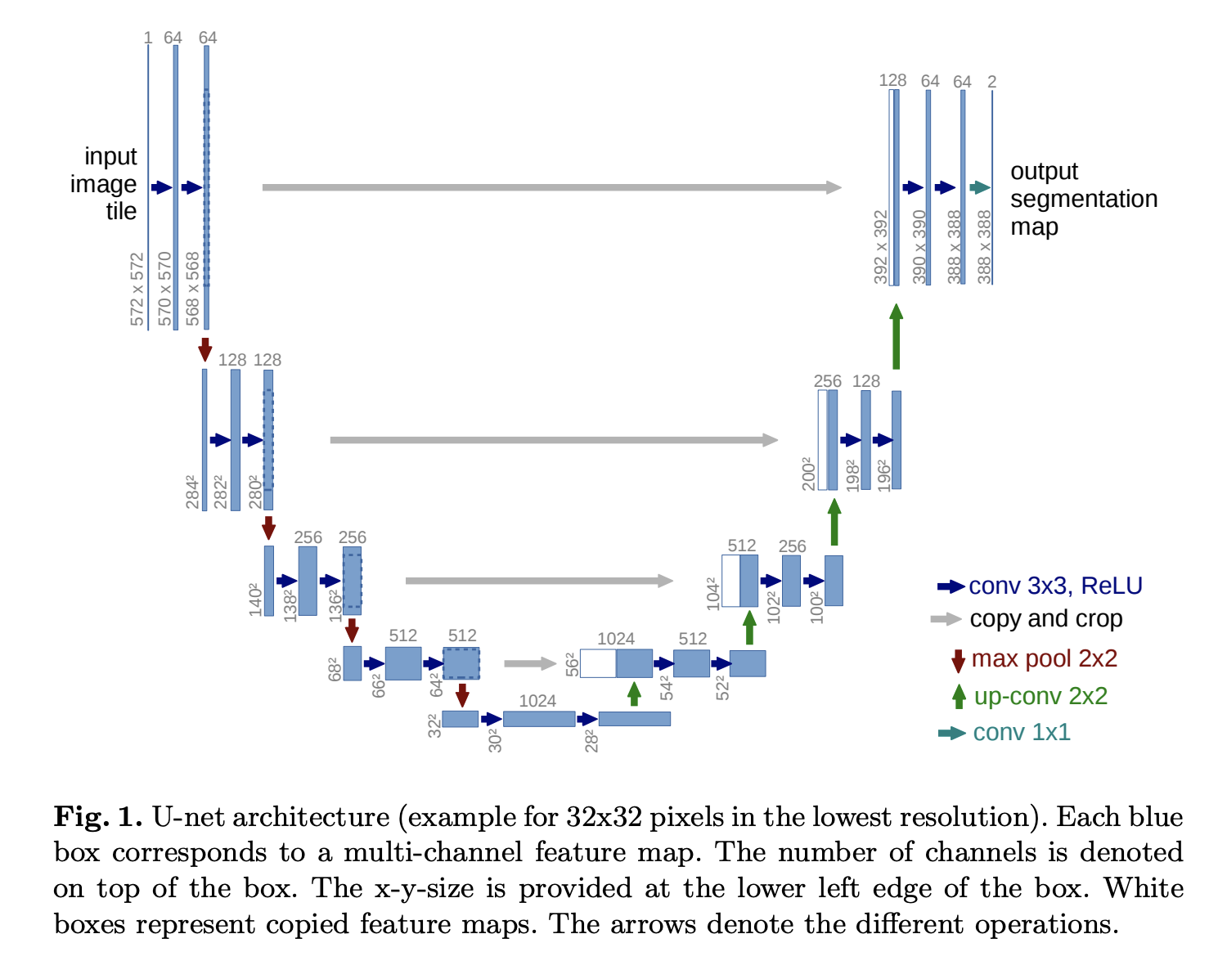
Denoise Predictor
We will need to learn the reverse diffusion process and for this we will use a neural network.
As we are working with images we will use a modified version of the U-Net architecture for this task
U-Net architecture
From: U-Net: Convolutional Networks for Biomedical Image Segmentation 2015

Slide 8


Loss function
Learnable funtion
Objective function
This loss funtion is imposible to learn
We can stablish a lower bound to our loss function
Constant term
Stepwise denoising term
Reconstruction term

Slide 9

Simplified Loss Function
This is the most simplified loss funtion we can use
In this loss function we don't calculate the denoise image, instead we predict the noise that have been added and by substracting it we obtain the denoise image

Slide 10


Time Embedding I
Our neural network will need a way of knowing how noisy is the image in which it is working
Both are equal for our neural network

Slide 11
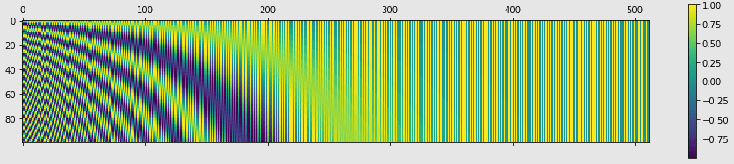

Time Embedding II
We will add a time embedding to our image in the same way as the postional encoding vectors in Transformers.

Slide 12


Comparating with and without attention
Without attention
With attention

Slide 13
Neural Network Architecture I
Main Blocks
Residual Block
C
O
N
V
O
L
U
T
I
O
N
A
C
T
I
V
A
T
I
O
N
B
A
T
C
H
N
O
R
M
C
O
N
V
O
L
U
T
I
O
N
A
C
T
I
V
A
T
I
O
N
B
A
T
C
H
N
O
R
M
Residual
Connection

Slide 14
Neural Network Architecture II
Main Blocks
Attention Block
L
I
N
E
A
R
Multihead-
attention
L
I
N
E
A
R
B
A
T
C
H
N
O
R
M
Residual
Connection

Slide 15
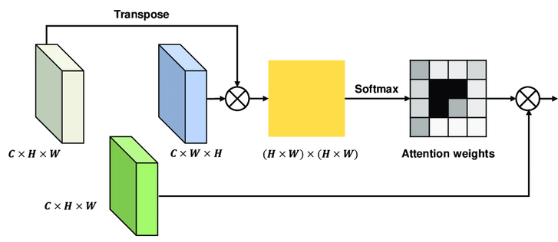
Neural Network Architecture III
Main Blocks
MultiheadAttention
Query
Key
Values

Slide 16
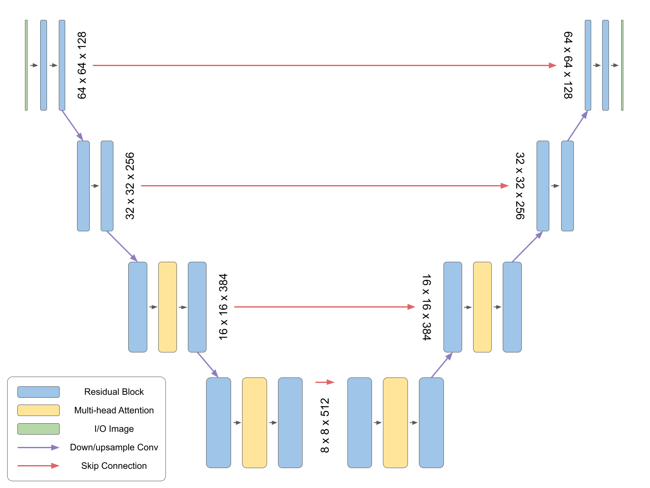
Neural Network Architecture IV
32
32
64
64
128
128
256
Architecture of the MinImagen implementation

Slide 17


Dataset I
First idea: Can we create our own dataset?
Main problem: Optimization
The datasets already incorporated in pytorch are highly optimized and this is a heavely consuming task.

Slide 18
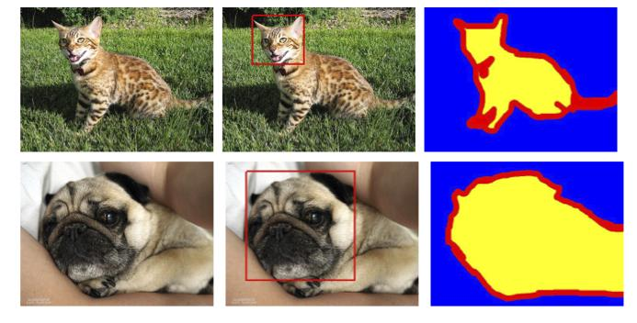
Dataset II
So we will use the Oxford-IIIT Pet dataset already integrated in pytorch
Main problem: Size of the dataset
This dataset includes 37 pets classes and 200 image for each class, but as we only want similar images we will not use all classes

Slide 19
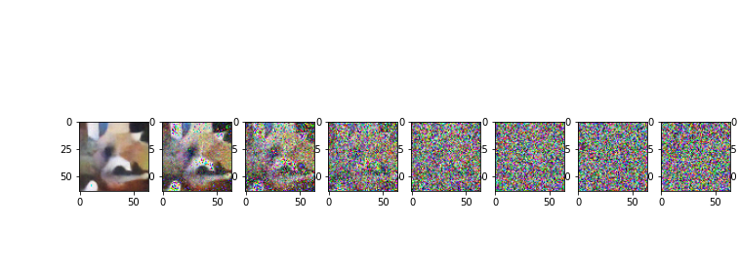
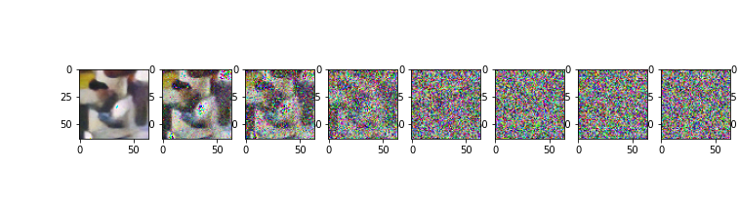
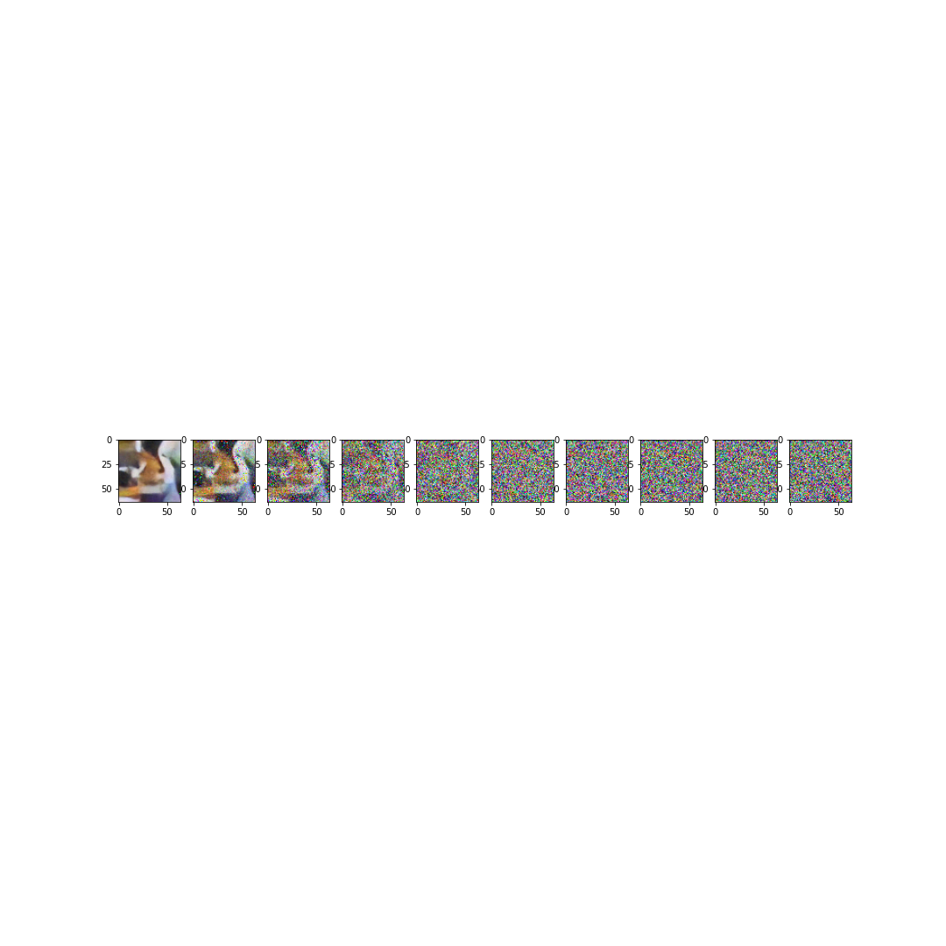
Results of the model I
After all of this, we end up with a model of 12.952.451 parameters that have been train for 600 epochs or around 8 hours.
This are some of the images that the model has generate.

Slide 20








Results of the model II
Let's compare some original images with the ones of the model
Original
Artificial

Slide 21








Results of the model III

Slide 22

Results of the model IV

Slide 23
References
Denoising Diffusion Probabilistic Models, 2020 , [Link]
Improved Denoising Diffusion Probabilistic Models, 2021, [Link]
Attention Is All You Need, 2017, [Link]
Photorealistic Text-to-Image Diffusion Models with Deep Language Understanding, 2022 [Link]
U-Net: Convolutional Networks for Biomedical Image Segmentation, 2015, [Link]

